Slide 1
Model Evaluation
Does your model make sense to someone else?

Slide 2
Overview
What is evaluation?
Why is it useful?
How do you evaluate environmental models?
Dealing with uncertainty.
Practical Evaluation Techniques
Pitfalls

Slide 3
Evaluation
Process of rigorously assessing model components, structure, parameter values, assumptions, but not scenario results
Commonly called model validation
Models represent a point of view of a system. Validation probably not the best term b/c it indicates a model can be true. Are opinions true?
Evaluation captures the essence of validation without connoting that the model is true
Process needs to ensure scientific defensibility and transparency

Slide 4
Evaluation con’t.
Is the model useful for its intended purpose?
Given the assumptions, structure, and assumptions, can the model be used for what the developers intended.
What are its limits and weaknesses?
Under what conditions does the model break?
Should you try to break it?
Is it re-creatable?
Notes:
Whooping Crane Example

Slide 5
Evaluation is often not Rigorous
Detailed evaluation is rare
Overly rely on software
Don’t have time
Aren’t concerned with recreatability
Discipline hasn’t required it
Small field & modeling was esoteric
But most agencies rely on models now
Increased need for scientifically-defensible and detailed documentation
TRACE (Transparent and comprehensive model evaluation)

Slide 6
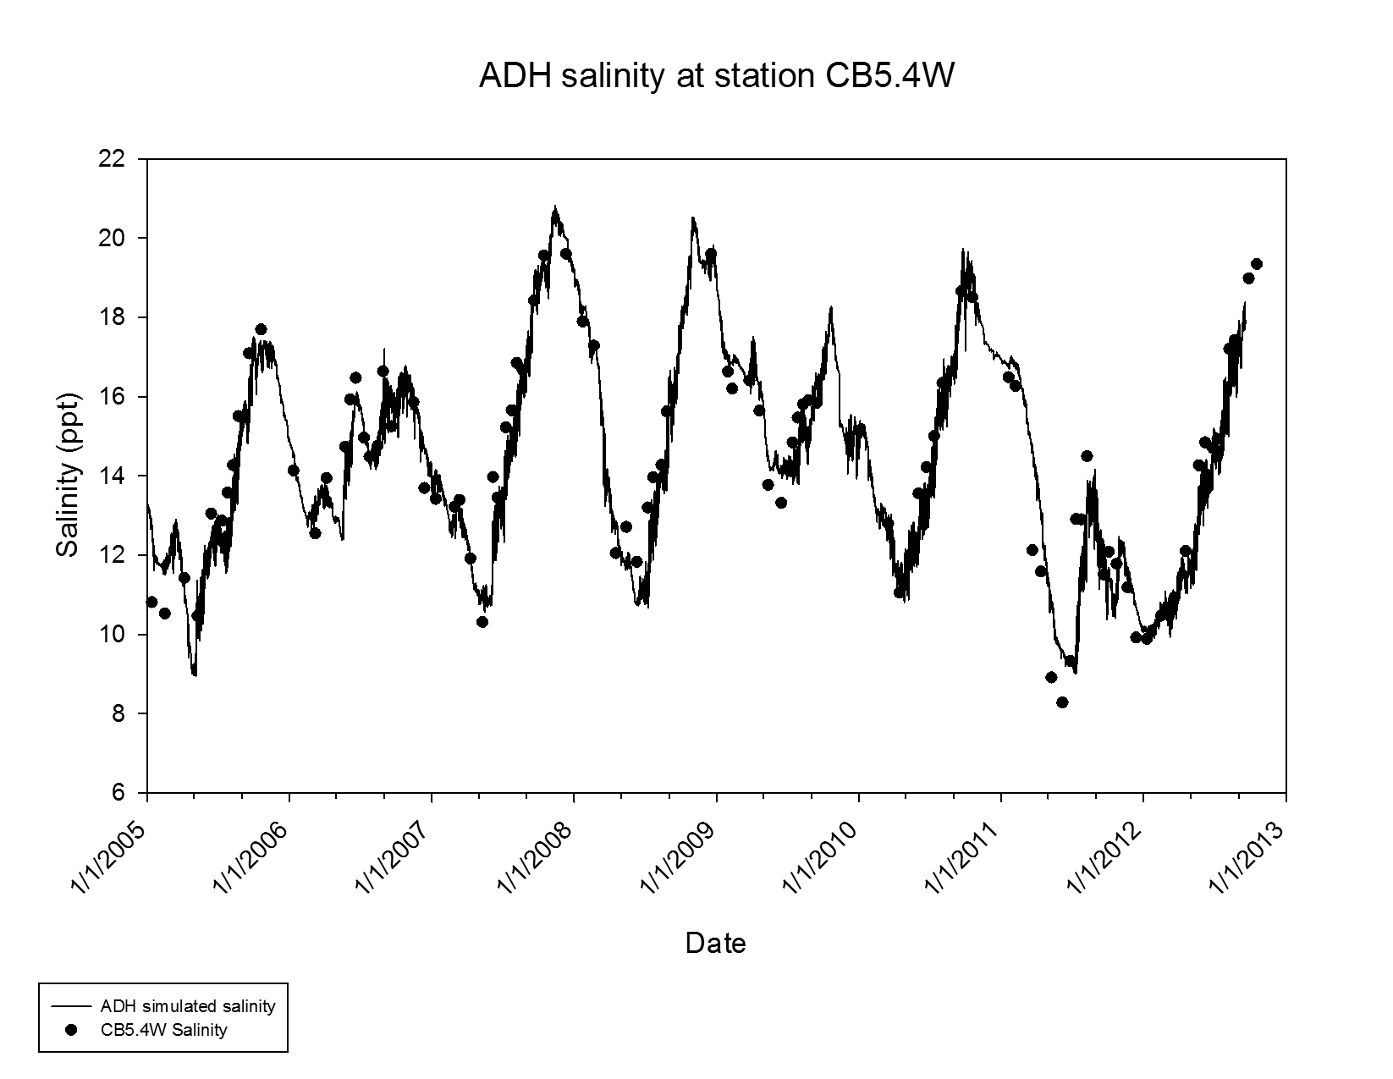
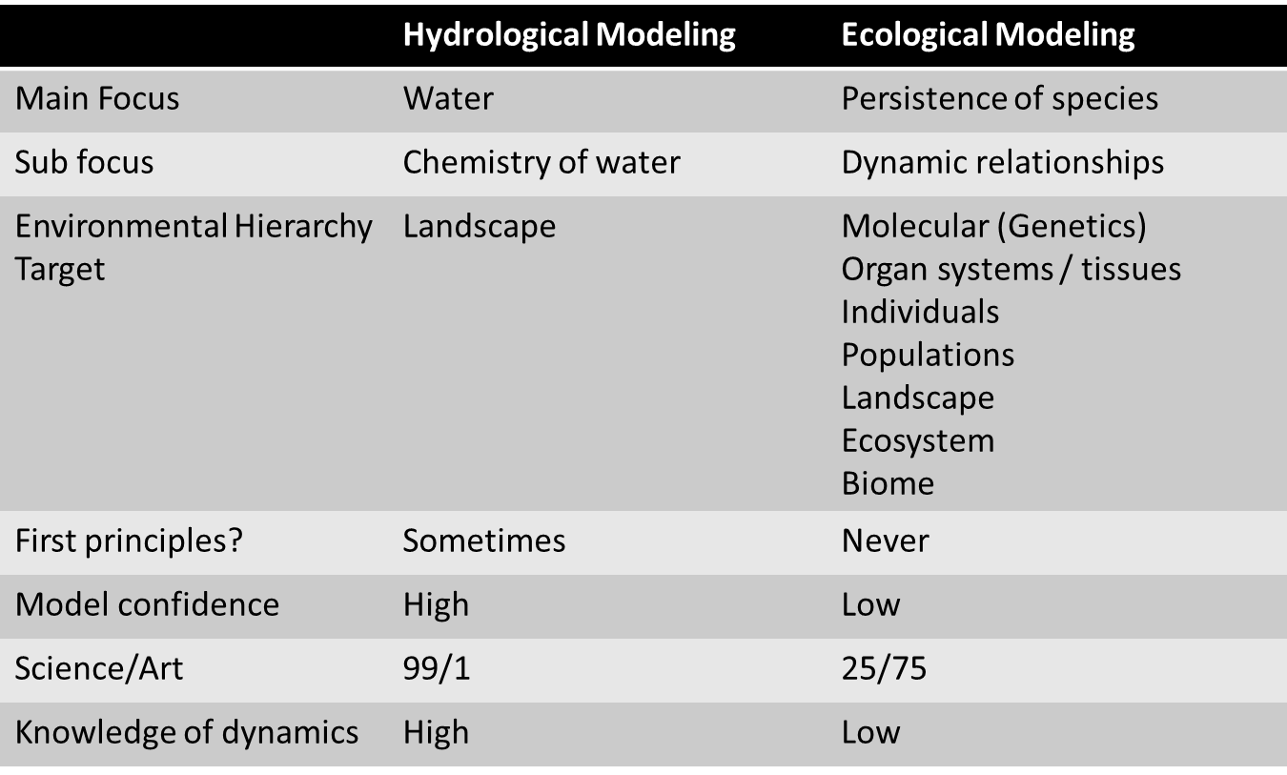
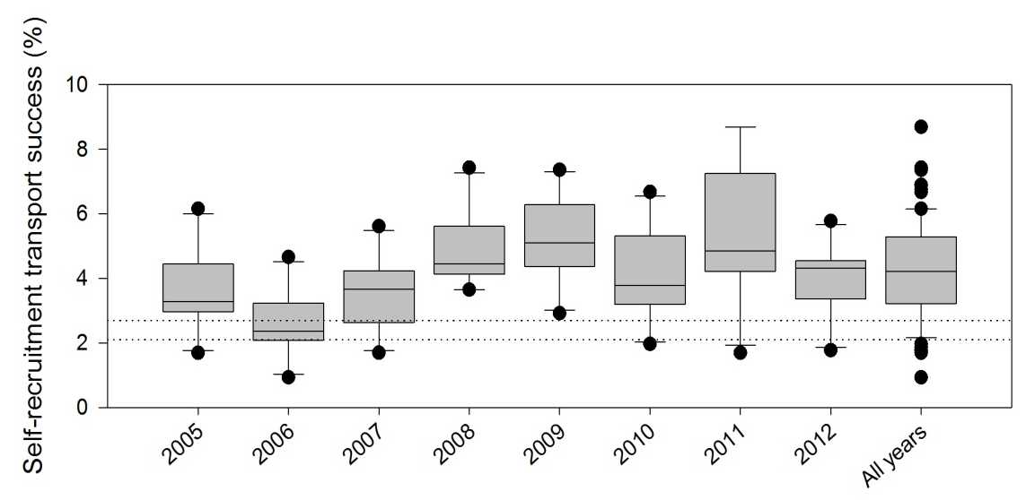
Problems with evaluation
Different disciplines have different expectations of model performance

Slide 7
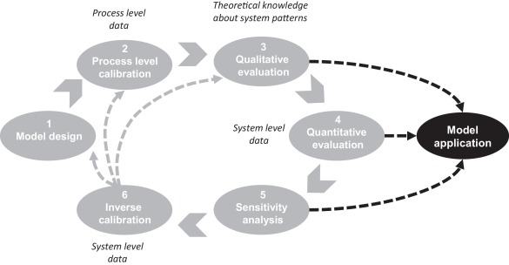
Problems with evaluation
Biggest issue is failure to document entire evaluation process
Iterative approach
Evaluation occurs throughout the modeling process, but is rarely documented thoroughly. Need to document each cycle.

Slide 8
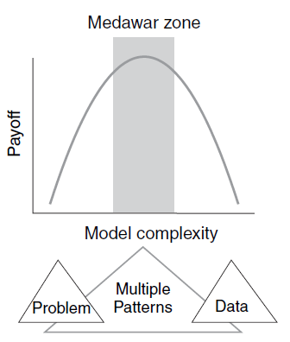
Pattern-oriented modeling
Technique for analyzing ecological models with emergent properties
Comparison of multiple, simulated system-level patterns to multiple observed and/or hypothesized patterns from real system
Moves away from p-values and statistics towards weight of evidence and critical thinking
Choosing patterns
Pattern is anything beyond random variation
Can be qualitative or quantitative
Need to be diverse & not correlated

Slide 9
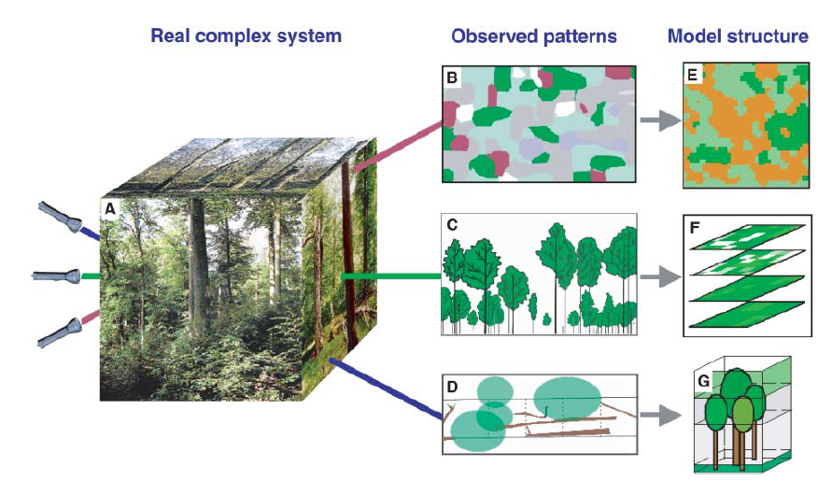
Pattern-oriented modeling
Mosaic of development stages
Vertical patterns of tree size
Fallen wood
Grimm et al., 2005

Slide 10
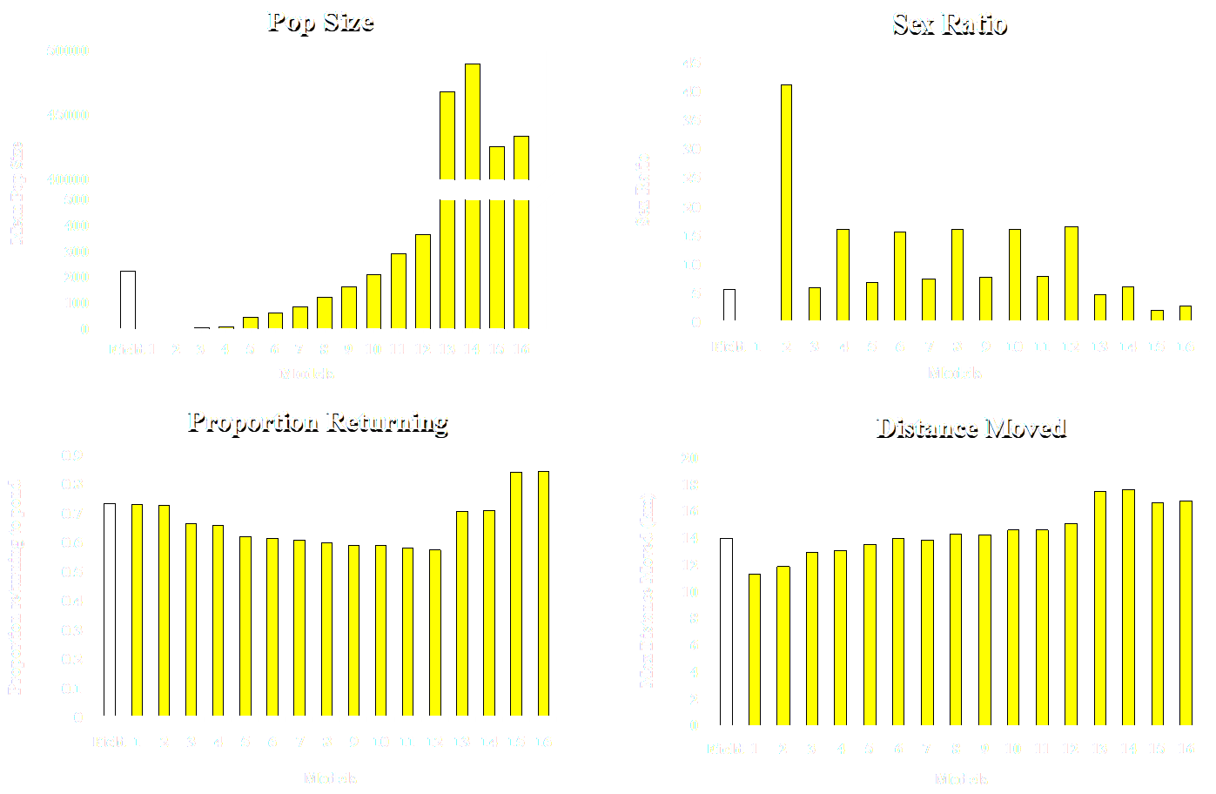
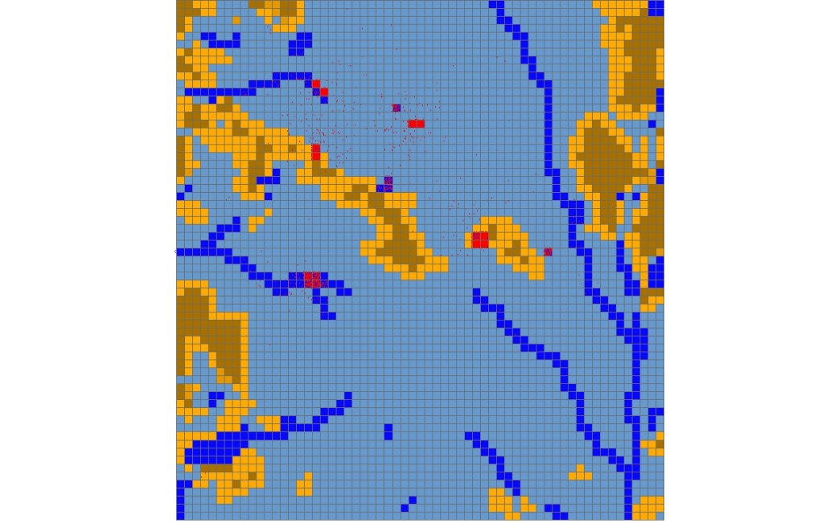
Pattern-oriented modeling
What level of juvenile survivorship leads to sustainable toad populations?

Slide 11
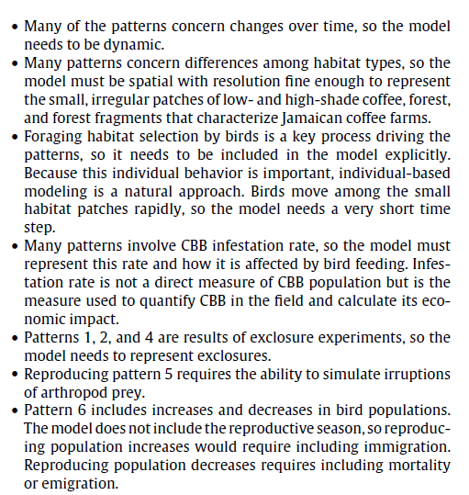
Railsback & Johnson 2011
Patterns for bird foraging and pest control of the coffee borer beetle (CBB)
Infestation rates increase over coffee season
In absence of birds, infestation rates are higher in low shade
Bird densities are higher in high-shade than low-shade
Positive relationship infestation rates in exclosures and % by which birds reduce infestation rate
Birds respond quickly to local irruptions on their normal food supply
Change in bird density within season related to food supply
Weak relationship between vegetation characteristics and bird density at intermediate scales
Bird movement distances (hourly) follow a log normal distribution
Bird consumption of CBB is episodic
What patterns tell us about structure

Slide 12
Steps in Evaluating environmental models
Assess reasonableness of model structure
Assess functional relationships & verify code
Evaluate model behavior vs expected patterns
Does model correspond well to data from real system? Does it matter?
Analyze uncertainty

Slide 13
Assess reasonableness of model structure
Does the structure make sense?
Absolutely required for explanatory models (most environmental models), but not really for correlative models, which are less focused on capturing relationships b/w variables
Somewhat subjective
Requires a priori hypotheses to test functional relationships
There are always simpler and more complex models

Slide 14
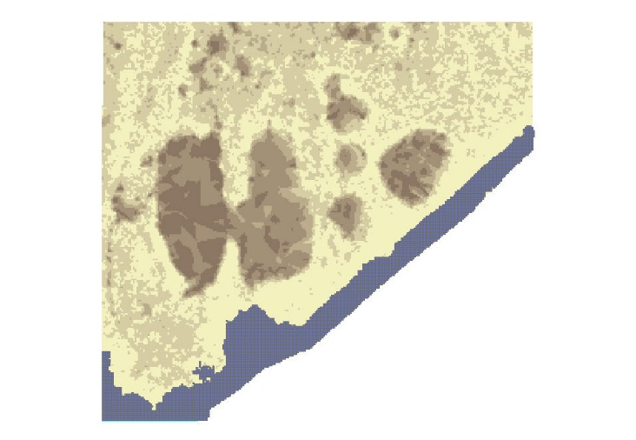
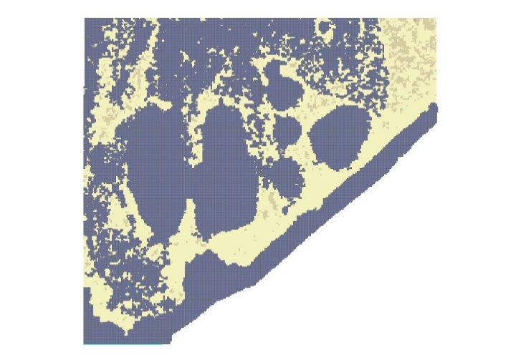
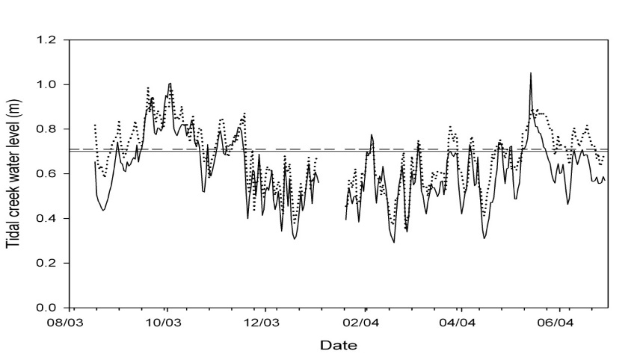
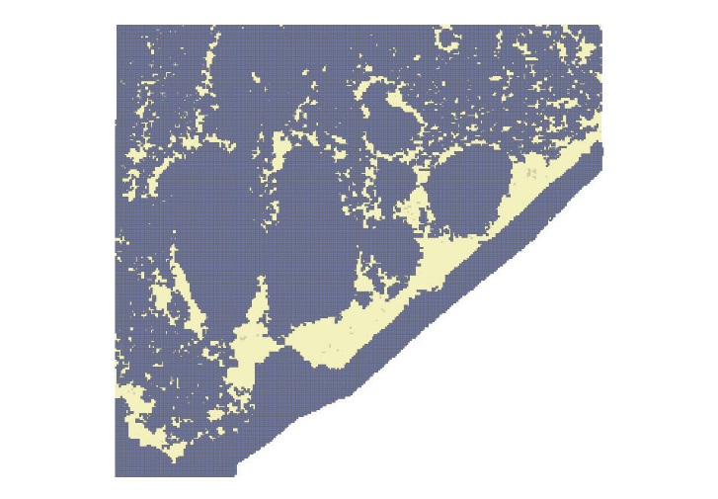
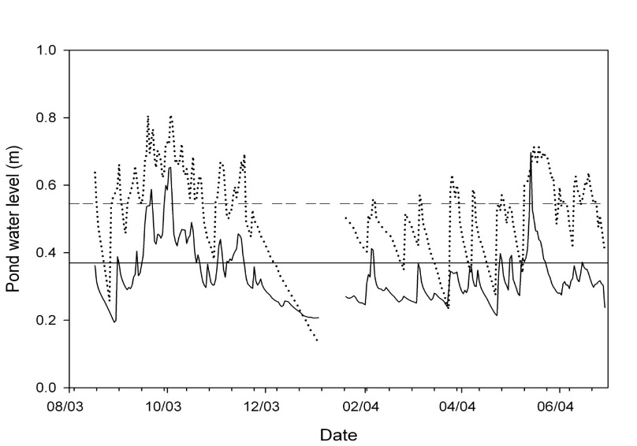
Example of Model Structure
SLOSH: the does water run uphill model

Slide 15
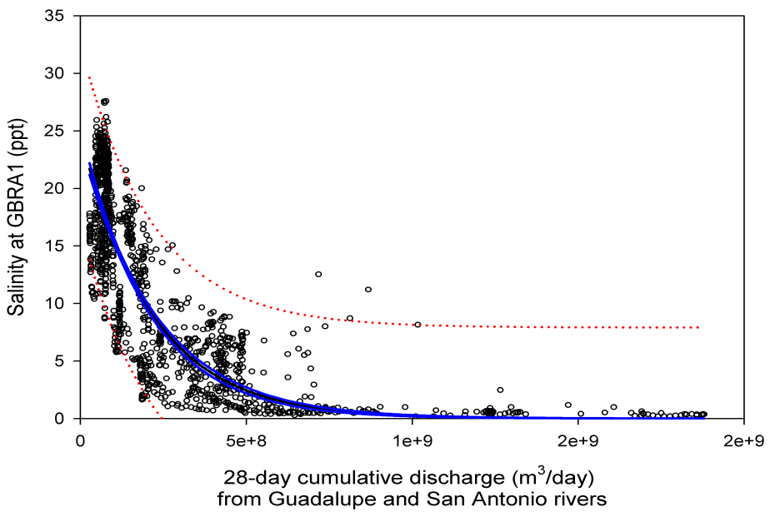
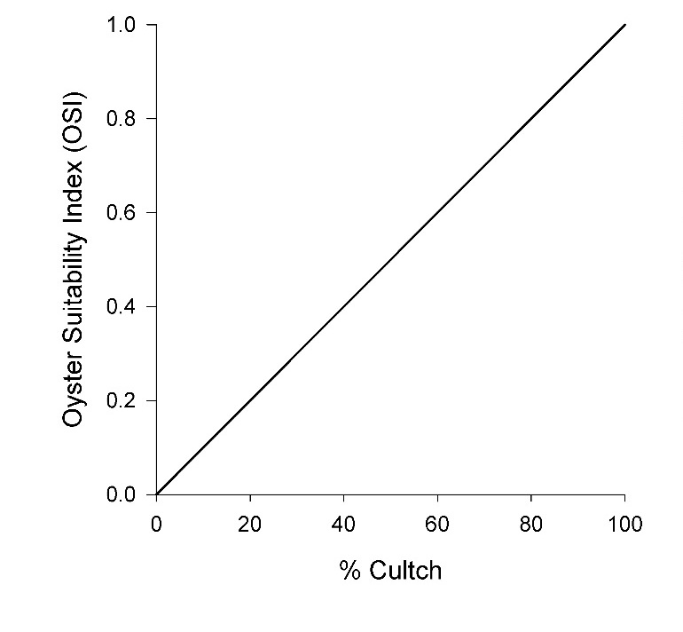
Do the Functional Forms make sense?
Do the functional forms of the equations generate reasonable output given the other components in the model?
Equations may not stand up after they’re coupled with other model components
Y = k*x^{-a}
Water is less salty with higher freshwater inflow
No Data, assume linear relationship b/c it’s simple and transparent
Discharge
Notes:
Data matched the assumptions for the salinity. No data for %Cultch, so had to guess. Linear function makes the most sense.

Slide 16
Evaluating Functions
Each function must be evaluated separately, then again when coupled to other components. Document each step!
t

Slide 17
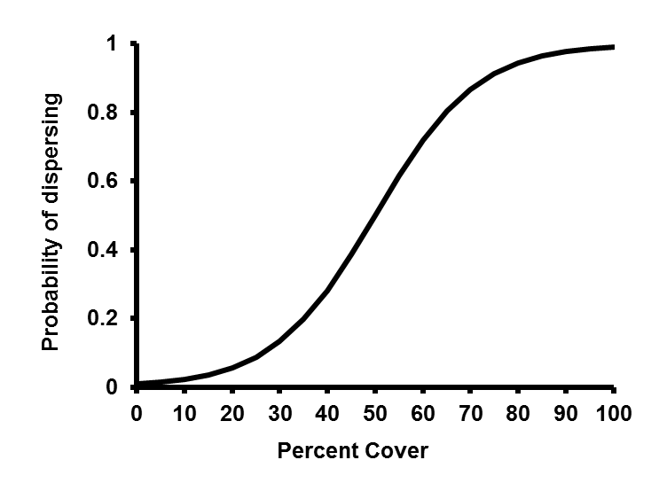
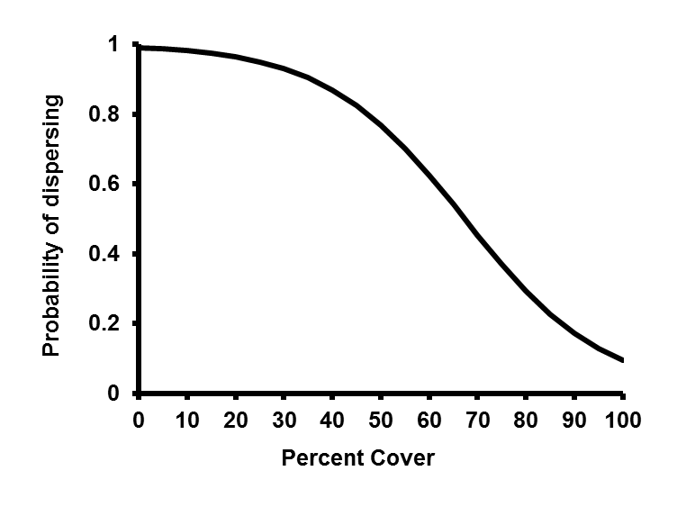
Does model act like you thought it would?
A priori expectations are critical for thorough evaluation
Without documenting expected patterns of behavior, it becomes difficult to ascertain whether the model is producing the correct values
Evaluate code and each function to make sure everything is being calculated correctly
Practice iterative evaluation

Slide 18
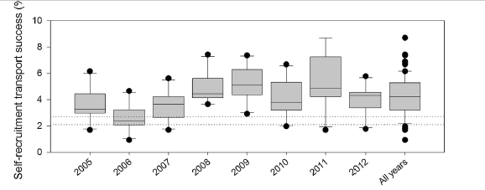
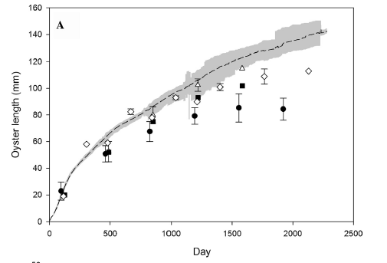
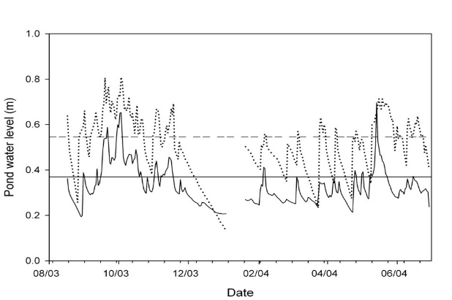
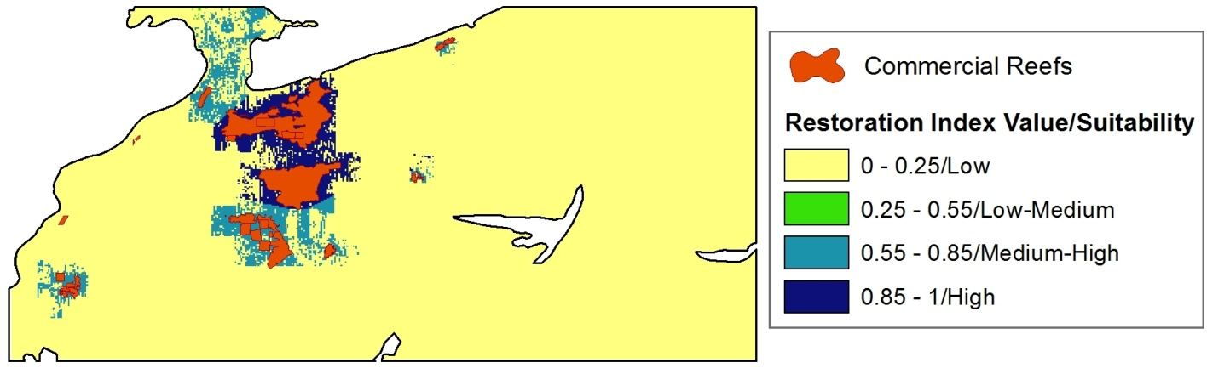
How does the model output compare to real data?
In general, environmental models are used to project system dynamics, so some understanding of how output compares to real data can be useful.

Slide 19
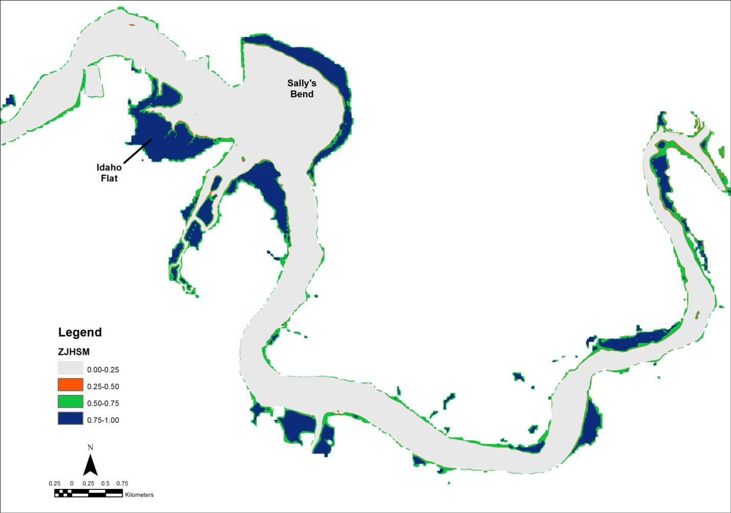
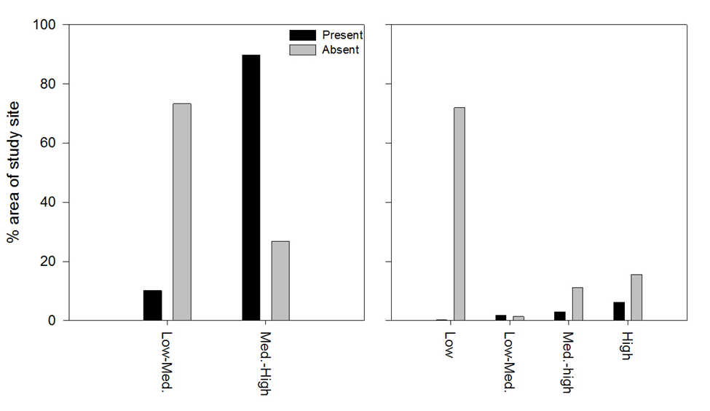
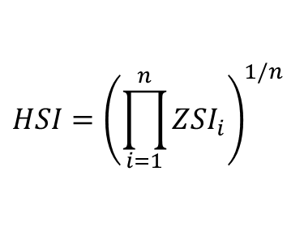
Seagrass example
Model does a good job of predicting presence of Z. japonica, as well as predicting its absence.
$$HSI={\left(\prod_{i=1}^{n}{{ZSI}_{i}}\right)}^{1/n}$$

Slide 20
Model sensitivity
Determines degree of response of model behavior to changes in various components.
Provides indication of relative precision of each parameter
Run model over range of values representing degree of uncertainty
Indicates level of confidence we have with model’s ability to address question

Slide 21
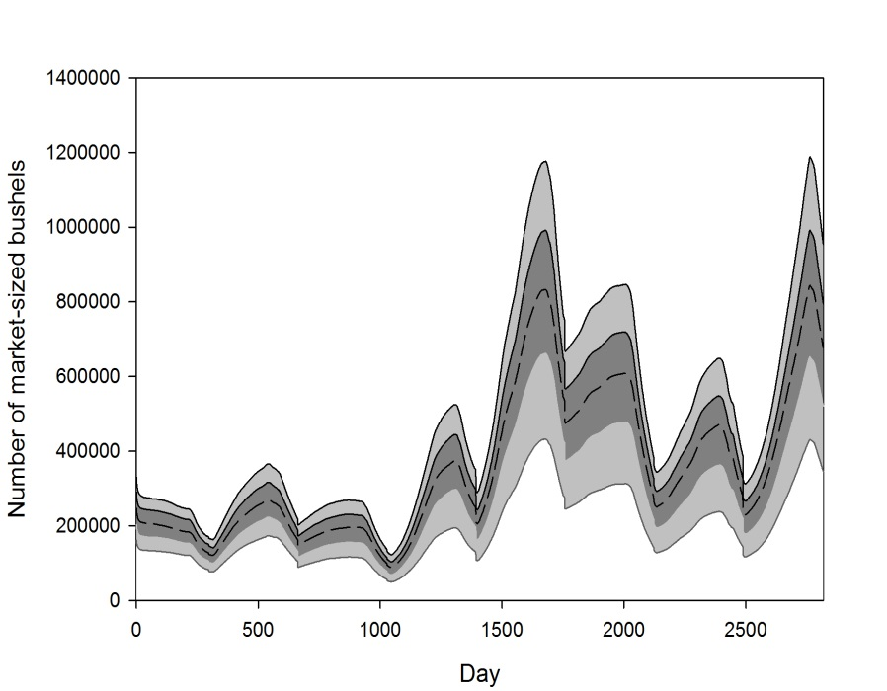
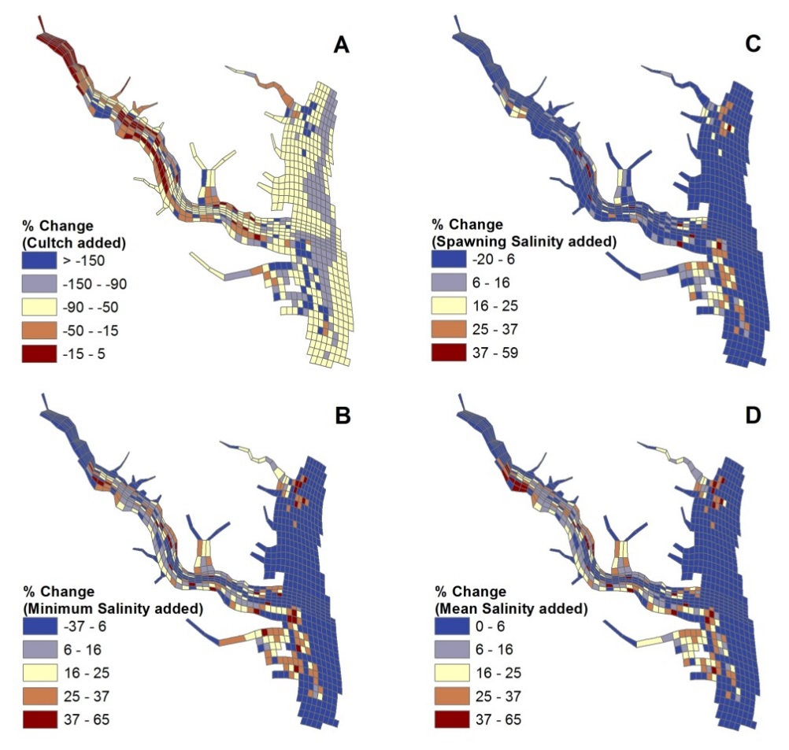
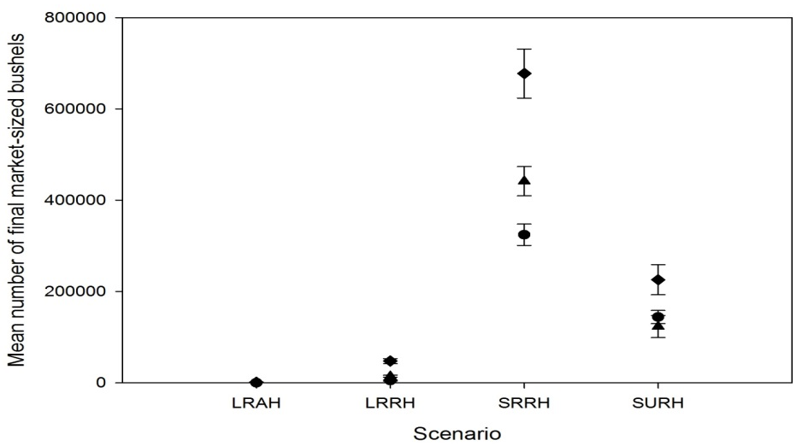
Model sensitivity

Slide 22
Discovering the model’s limits
How does the model perform under extreme circumstances?
Run model across wide range of values outside of range
Break the model!
Critical for understanding how model functions across a wide range of conditions.

Slide 23
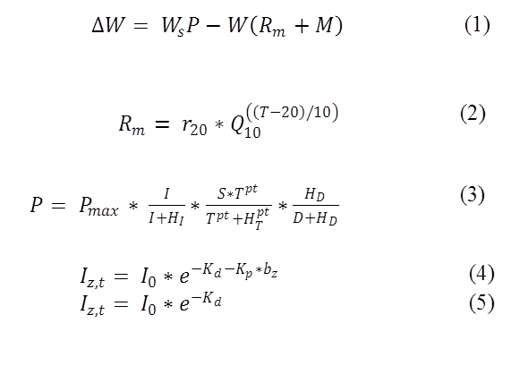
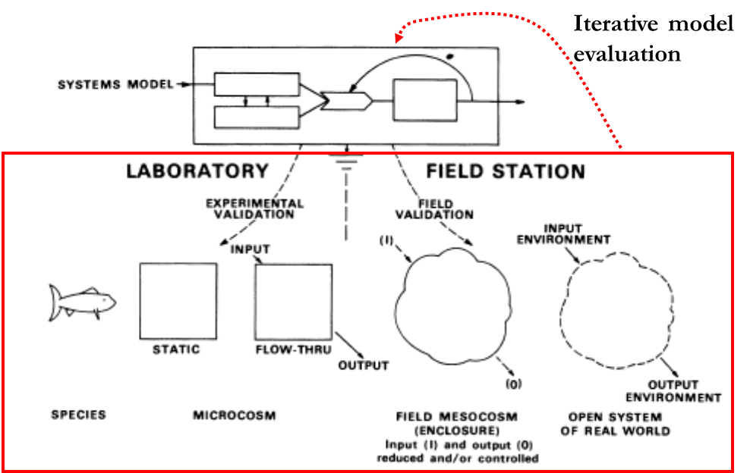
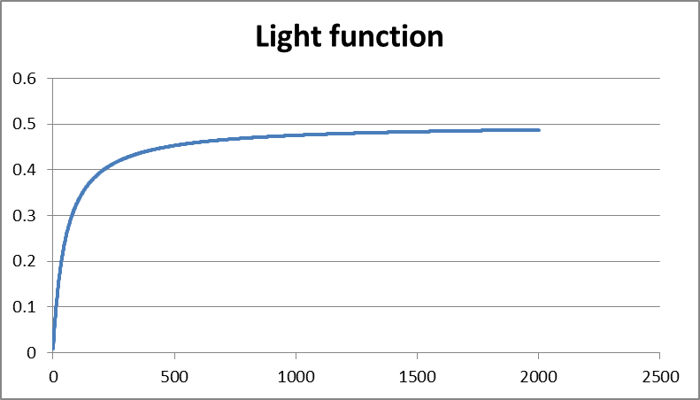
Pitfalls
Failure to iteratively evaluate and document each step

Slide 24
Pitfalls
Underestimating importance of qualitative components of model
Does it look right?
Accepting conceptually flawed functional relationships
Immediately places you in position to defend

Slide 25
Pitfalls
Acceptance of surprising model results
“Hmmm…that seems weird. Oh well.”
Need to figure it out and document it!
Could be coding issue, flawed conceptualization, quantification, etc..
Interpreting initial results without letting model burn-in
Initial behavior might not represent model patterns
Resulting from initial conditions and parameter values

Slide 26
Pitfalls
Over-reliance on automated evaluation techniques
Canned software cannot provide level of rigor needed for complex models
Over-reliance on statistics
Statistical and practical significance aren’t always the same thing

Slide 27
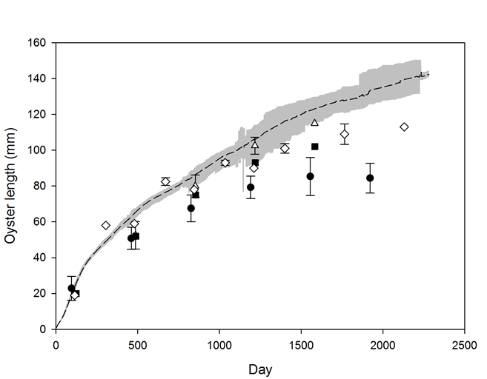
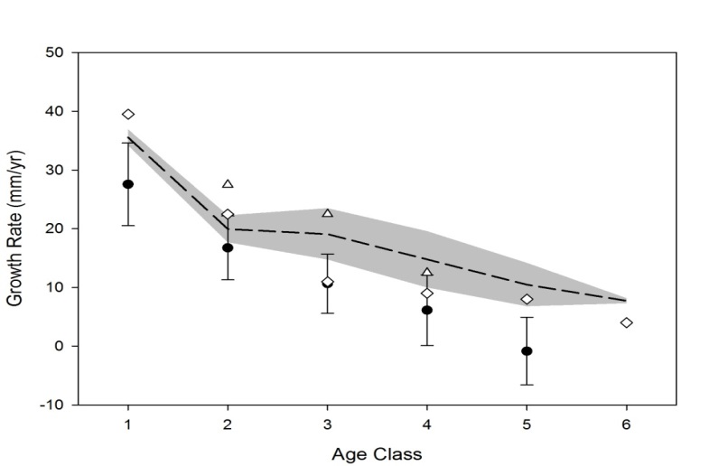
Pitfalls
Believing data from real system are correct
Field data were collected over a specific period of time, under a particular set of environmental conditions.
May not necessarily correlate with model projections

Slide 28
Pitfalls
Careless design of sensitivity analysis
What parameters actually make sense for a sensitivity analysis?
Tendency to equate model sensitivity with model failure

